Slide 1

Website Revamp: Technical Requirements Brief
Rebuild fli-online.org as a modern, responsive, research-friendly WordPress site: design, repository and search, migration, subscribers, SEO, security and performance.
Prepared by: Sadia Maula Dad, Technical Consultant
For shortlisted vendors | Confidential | 13 October 2026

Slide 2
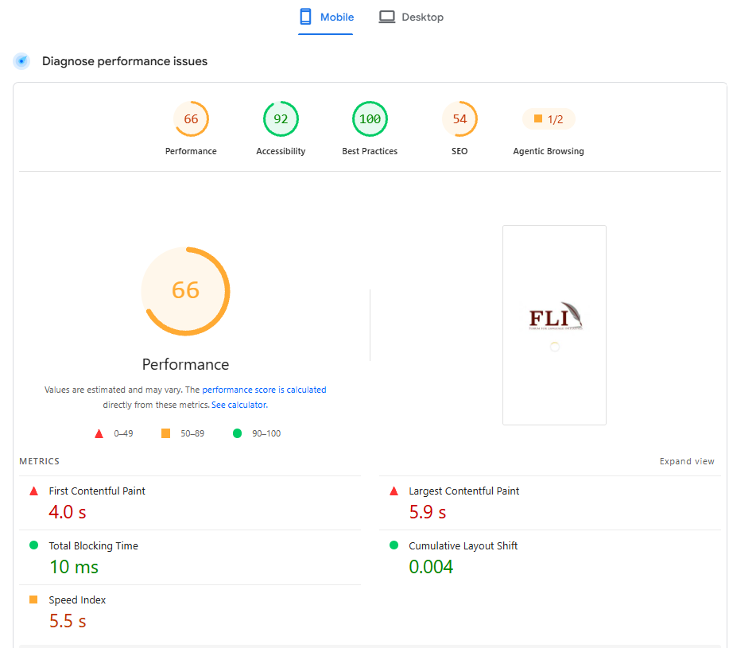
Current site baseline
Metric | Desktop | Mobile
Performance | 90 | 66
Accessibility | 92 | 92
Best Practices | 100 | 100
SEO | 54 | 54
First Contentful Paint | 0.9 s | 4.0 s
Largest Contentful Paint | 1.4 s | 5.9 s
Total Blocking Time | 0 ms | 10 ms
Layout shift (CLS) | 0.001 | 0.004
Speed Index | 2.3 s | 5.5 s
Security headers grade | D | D
Mobile capture shows only a loading screen. Source: Google PageSpeed Insights and a security headers scan, 12 Oct 2026. Current stack: WordPress with Elementor.
Vendors must re-measure on the live site during discovery.

Slide 3
Targets at a glance
Measure | Current | Target
Performance, mobile | 66 | 85+
Performance, desktop | 90 | 95+
SEO score | 54 | 90+
Best Practices | 100 | Keep 100
First Contentful Paint (mobile) | 4.0 s | 1.8 s or less
Largest Contentful Paint (mobile) | 5.9 s | 2.5 s or less
Total Blocking Time (mobile) | 10 ms | 200 ms or less
Layout shift (CLS) | 0.004 | 0.1 or less
Security headers grade | D | A
Accessibility | 92 (Lighthouse) | WCAG 2.1 AA on core templates

Slide 4
Performance fixes and targets
Finding (mobile unless noted) | Required action | Acceptance
Loading screen blocks first paint | Remove, or make non-blocking | Real content in first paint
Render-blocking requests (2,930 ms) | Inline critical CSS, defer the rest, lean theme | Audit cleared
Font display (580 ms) | Self-host, font-display: swap, preload | Audit cleared
LCP discovery, request chains | Preload hero image, avoid chains | LCP at most 2.5 s
Cache lifetimes (72-95 KiB), legacy JS | Long cache headers (CDN allowed), modern JS | Audits cleared
Images (55 KiB mobile, 203 KiB desktop) | WebP/AVIF, srcset, lazy-load | No oversize images
Unused JS 126 KiB, CSS 25 KiB, minify | Drop unused plugin assets, minify | Audits cleared
Animations, long task, forced reflow | Animate transform/opacity only | TBT at most 200 ms
Targets on key templates: mobile Performance 85+ (desktop 95+), FCP at most 1.8 s, LCP at most 2.5 s, CLS at most 0.1, Best Practices 100.

Slide 5
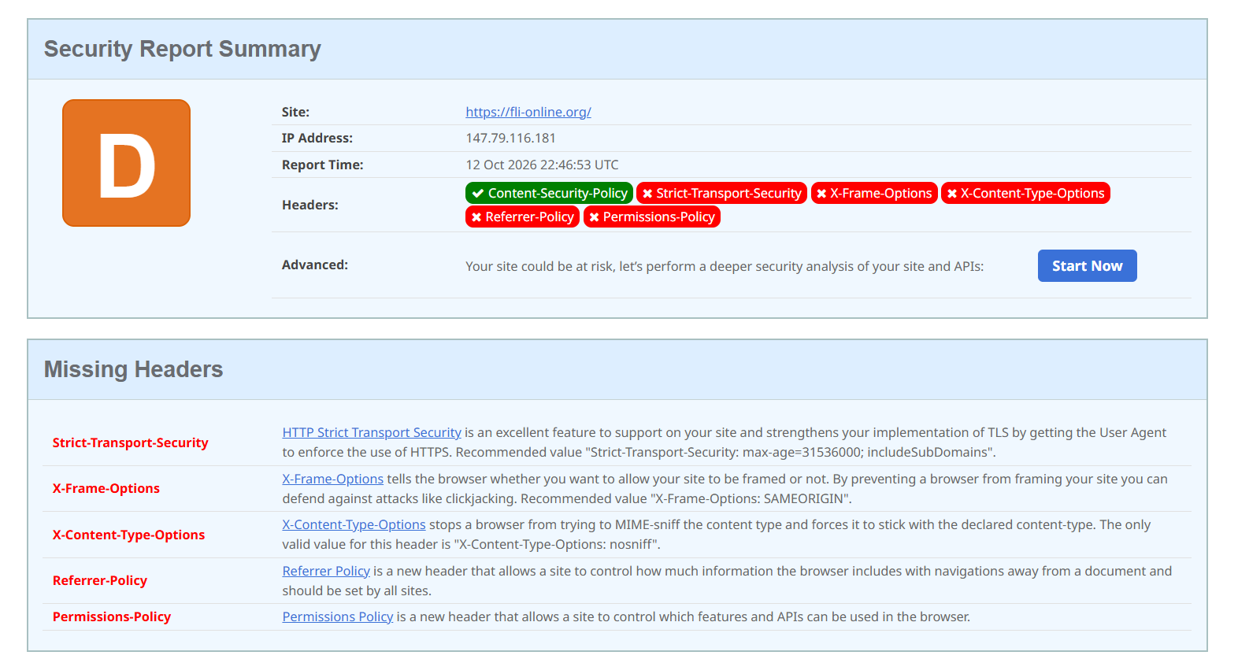
Security
Requirements
Add all five missing headers; target grade A
Review the CSP: add frame-ancestors, avoid broad unsafe-inline
Force HTTPS with a 301; roll out HSTS in stages
WAF or Cloudflare, admin 2FA, login protection
Tested daily off-site backups; defined update policy
Delete temporary migration files after verification
Strict-Transport-Security: max-age=31536000; includeSubDomains
X-Frame-Options: SAMEORIGIN
X-Content-Type-Options: nosniff
Referrer-Policy: strict-origin-when-cross-origin
Permissions-Policy: camera=(), microphone=(), geolocation=()

Slide 6
Technical SEO
Search visibility
Structure and tracking
Remove "noindex, nofollow" before launch
Lighthouse SEO 90+
Unique titles under 60 characters; meta descriptions
One H1 per page, logical heading order
Crawlable links with descriptive text; no "#" or bare "Learn more"
Canonicals, XML sitemap, robots controls
Schema markup: Organization, Event, book and scholarly article
301 map for every old URL, including /site/ paths and placeholder pages
Clean, consistent URLs; no duplicate "-2" pages
Internal linking plan
Search Console and GA4 (both free), monthly dashboard

Slide 7
SEO: content and discoverability
Content and on-page
Multilingual and research reach
Keyword and search-intent research for researchers, language communities, partners and donors
Titles and meta descriptions written for each key page, per language
Descriptive headings, URLs, image file names and alt text
Social sharing previews (Open Graph)
Breadcrumbs and internal links between related publications, languages and news
Language tags and hreflang for English and Urdu pages
Search-friendly metadata for RTL pages
Publication metadata (title, author, year, abstract, PDF link) in scholarly-indexing formats where feasible
Structured data checked with Google tools
PDFs with proper titles and properties

Slide 8
SEO: launch and monitoring
Before launch
First 30 days after launch
Baseline snapshot: top pages, Search Console data, backlinks
Staging blocked from search; "noindex" absent on the live site
Every old URL tested against the redirect map
robots.txt, canonicals, HTTPS and sitemap reviewed; sitemap submitted
Lighthouse SEO 90+ and PageSpeed targets met
Weekly checks of indexing, crawl errors and 404s
Fix redirect or indexing problems quickly
Compare impressions and clicks with the baseline
Monthly dashboard from GA4 and Search Console
Short written report to FLI during handover
FLI will monitor the Monthly dashboard for next 2-3 month after launch

Slide 9
Design, UX and responsive layout
Modern responsive layout (mandatory)
Accessibility, language and conversion
Replace the dated look with a clean, modern, card-based design
Mobile-first fluid grid; tested at 360, 768, 1024 and 1440 px
No horizontal scrolling; touch targets at least 44 px
Fluid typography, responsive images, simple sticky navigation
Wireframes, two clickable design directions, 2 revision rounds, design system
Real-device testing on common Android and iOS phones
WCAG 2.1 AA: contrast, keyboard, focus, alt-text workflow
Urdu and RTL layouts; Unicode fonts for indigenous scripts
Menu at most 3 levels; prominent global search
Clear calls to action: donate, partner, volunteer, subscribe
Dated impact figures; remove unsupported claims
Complete footer: privacy, terms, address, working email

Slide 10
Site structure and content
Main sections
Content types
Publishing features
Home
About FLI
Programs / Our Work
Languages and Communities
Research and Publications
News and Events
Media and Resources
Get Involved
Contact
Publications
Resources
News
Events
Languages
Projects / Programmes
Team
Final structure confirmed in discovery
Blog / news and event listings
Social media integration
Contact and engagement forms
Publication pages: abstract, citation, download, related items
Branded email templates
Internal and external links checked

Slide 11
Research, CMS and email
Research repository
CMS and roles
Subscribers and email
Fields: title, author, year, language, type, topic, series, ISBN, summary, cover, file
Faceted filters
PDF full-text search
Book and scholarly schema
Roles: admin, editor, author, contributor
Reusable blocks and layouts
Staff publish without a developer
Structured fields keep layouts safe
Secure export, dedupe, keep consent status
Migration report; delete temp files
Double opt-in, one-click unsubscribe
Automated emails via Mailchimp, Brevo or equivalent

Slide 12
Language, compliance, migration
Multilingual
Forms and compliance
Content migration
English and Urdu with RTL at launch
Structure ready for indigenous scripts
Keep language map, tree and relatedness pages
Hide spam traps; add consent text
Rewrite cookie banner: fonts, maps, avatars, video
Privacy policy and terms pages
Spam protection on all forms
Keep fonts, software, keyboards, publication series, newsletters, news archive
Retire stale items (COVID-19) with approval
Fix broken and duplicate pages

Slide 13
Discovery and design
Discovery
Design
Content audit and inventory spreadsheet
Stakeholder workshops
Up to 6 user interviews: researchers, partners, community users
Sitemap, taxonomy and user journeys approved before design
Wireframes for key templates
Two clickable design directions to choose from
Up to 2 revision rounds
Design system
Sample pages: Home, About, listing, resource detail, News/Event, Contact

Slide 14
Build, QA and handover
Build and QA
Launch and handover
Staging site, weekly demos, written status
One project manager; sign-off at each phase
Cross-browser, link, redirect, metadata, sitemap and backup/restore checks
One consolidated UAT correction cycle
DNS cutover and go-live monitoring
2 training sessions (90 min; in person in Islamabad if needed)
Editor guide and short videos
Source files and licences in the name of FLI
30 days support minimum; maintenance plan priced separately

Slide 15
Dependencies and scope limits
FLI provides
Out of scope
Existing hosting and domain/DNS access
Database and subscriber source access
Analytics and Search Console access
Branding assets
One focal person
Consolidated feedback within 2-3 working days
Copywriting and translation
OCR of scanned archives
Mobile apps and member portals
Payment systems: the donate button links to the existing method
Custom databases outside WordPress
Anything else is quoted separately

Slide 16
Acceptance tests
Quality
Content and email
PageSpeed re-run, mobile and desktop, against the targets
Security headers scan: grade A
WCAG 2.1 AA checks, including keyboard use
Cross-browser and real-device checks, phones included
Lighthouse SEO 90+ targets met
Every old URL tested against the redirect map
Search readiness: no "noindex", sitemap, Search Console
Email flows: sign-up, confirmation, unsubscribe, notification
Backup and restore test

Slide 17
What we still need from you
Please do not resend
Please send only what is missing
Fee breakdown
Schedule and milestones
Payment terms
Scope description
Portfolio and company profile
Recurring costs not yet priced: add-on licences, email platform tier, maintenance plan
2-3 verifiable references with contact details
Written confirmation of the targets in this brief, including modern phone-friendly design, Urdu/RTL and the donate/partner button
If a change affects price or schedule, state only the change

